Slide 1
Analyzing Aviation Risks: Recommendations for Aircraft Acquisition

Slide 2
Table of contents
01
IMPACT OF AIR TRAVEL
BUSINESS PROBLEM
02
IMPORTANCE OF AIR TRAVEL
AVIATION’S ROLE IN SOCIETY
IMPORTANCE OF THIS ANALYSIS
UNDERSTANDING AVIATION RISKS
CONSEQUENCES OF AVIATION ACCIDENTS
IMPORTANCE OF AVIATION SAFETY

Slide 3
December.17.1903!
The first powered, controlled, and sustained flight by humans
As of 2024
the global airline industry performs around 38.7 million flights annually !!!

Slide 4
01
IMPACT OF AIR TRAVEL
AVIATION A CATALYST FOR GROWTH

Slide 5
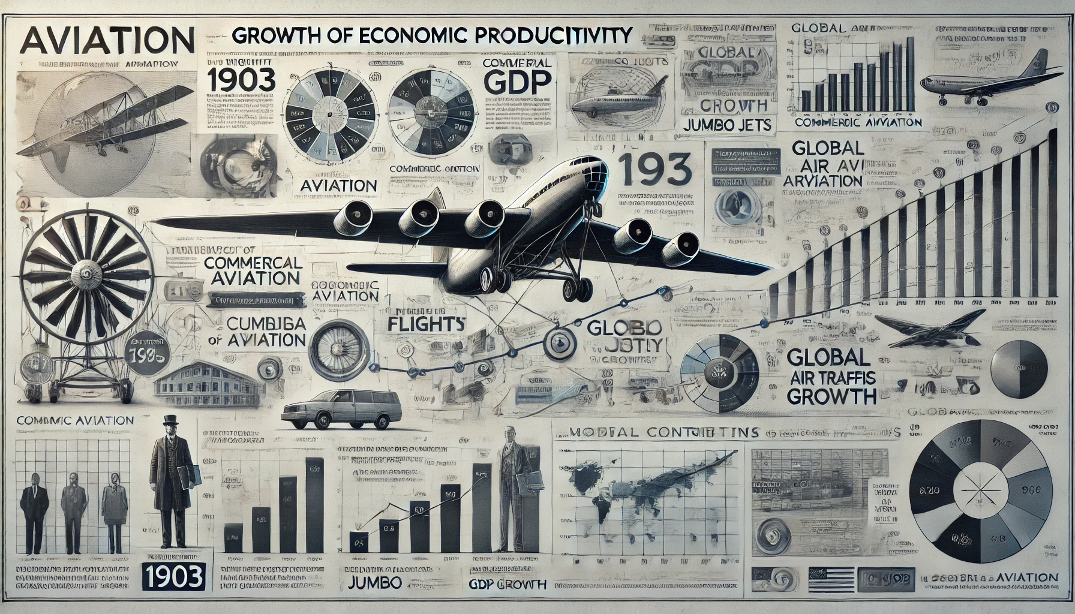
3.5 Trillion
4.7 Billion
6.7 Trillion
58%
In 2024, 4.7 Billion passengers used air travel
Worth of goods representing 35% of Global Trade value was transported as air freight
Of Global Tourists rely on air travel
Aviation contributed 3.5 Trillion dollars (4.1% ) of the global GDP
Notes:
Aviation contributes over $3.5 trillion to the global economy, representing 4.1% of the global GDP​
.Around 4 billion passengers are transported annually, highlighting its central role in mobility.
Over 65 million jobs globally are supported by aviation and related sectors.

Slide 6
1. Economic Impact
Global Trade and Connectivity:
Tourism Growth.
Job Creation
Revenue and Taxes
2. Social Impact
Uniting Families
Globalization and Cultural Exchange.
Emergency Services
Humanitarian Aid.
3. Strategic and Political Importance
National Security:
Diplomatic Connectivity:
Notes:
Air travel facilitates international trade by enabling the rapid transportation of goods. The aviation industry connects global markets, allowing businesses to expand their reach
Tourism heavily relies on aviation, contributing significantly to GDP in countries worldwide. For instance, air travel supports approximately 58% of international tourist arrivals globally​
Aviation generates millions of direct and indirect jobs. Pilots, airport staff, maintenance crews, and related industries, such as hospitality and travel agencies, benefit from the aviation sector's growth.
Governments collect significant revenue through airline taxes, airport fees, and related services. This revenue is often reinvested in infrastructure development.
Social Impact:
Air travel allows families separated by long distances to connect quickly and efficiently.
Aviation has made the world more accessible, fostering cultural exchange, understanding, and global collaboration
Aviation plays a crucial role in medical emergencies, including transporting organs, vaccines, and critical patients.
Airlines are instrumental in delivering aid to disaster-hit regions, offering swift and efficient transportation of food, supplies, and rescue teams
Strategic and Political Importance:
Many governments use aviation for defense and intelligence purposes.
Air travel enables fast diplomatic missions, negotiations, and global summits

Slide 7
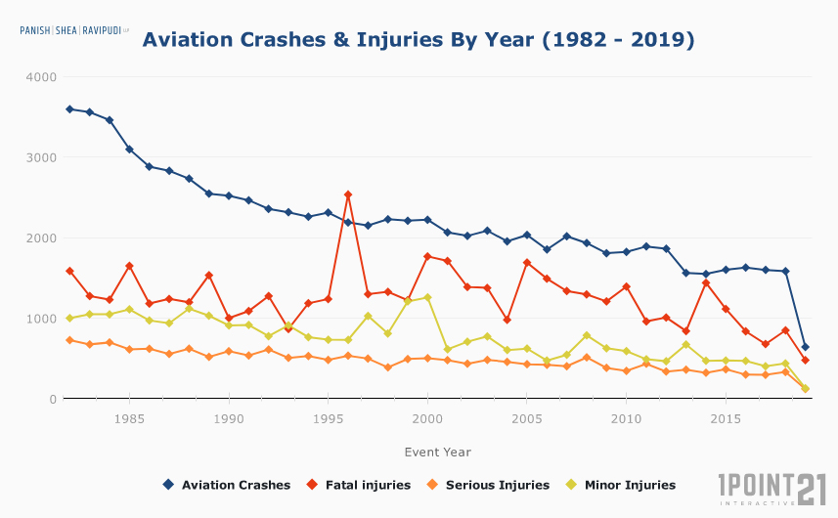
Risks in Aviation
Plane travel is among the safest modes of transportation.
However, when aviation accidents do happen, the results are often catastrophic
Minor airplane collisions or crash landings, are devastating, life-altering events
In 2007, the National Transportation Safety Board estimated a total of nearly 24 million flight hours.
Of these 24 million hours, 6.84 of every 100,000 flight hours yielded an airplane crash, and 1.19 of every 100,000 yielded a fatal crash.
This is down from an all-time high of 9.08 accidents per 100,000 hours in 1994.

Slide 8
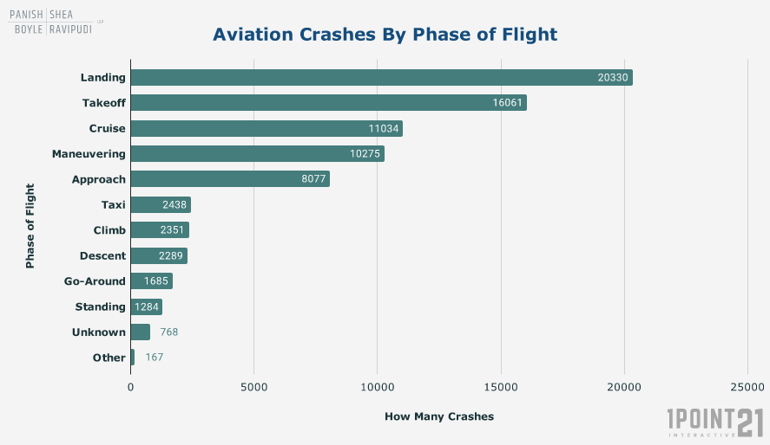
Aviation Crashes
Landing and Takeoff are the most complex phases of flight for any airplane.
Nearly half of all the aviation crashes analyzed between 1983 – 2019 took place during either landing or take off procedures
Notes:
These phases place a heavy load on airline crews and ground teams as well.
The tough combination of constant airplane configuration changes, having to navigate the plane, communicating with Air Traffic Control, and keeping an eye on ever-changing weather conditions increases the potential for unanticipated events which sometimes leads to a crash.

Slide 9
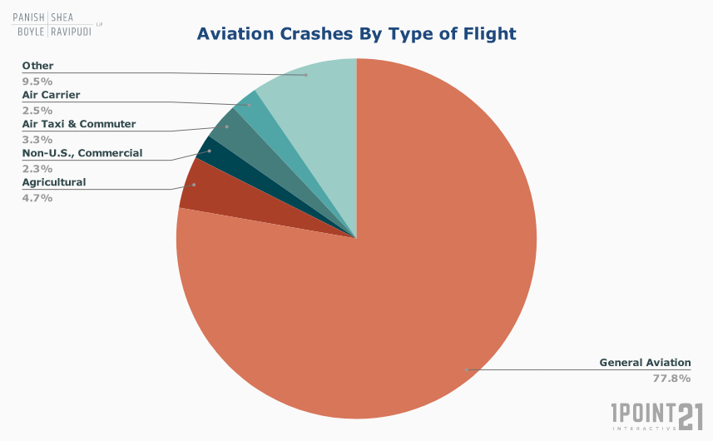
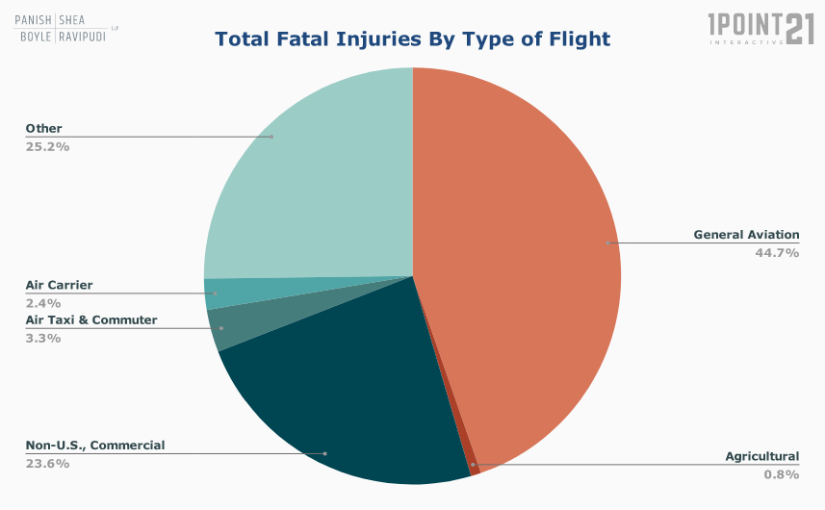
Type of Aircrafts involved
general aviation aircraft were involved in almost 78% of all crashes.
percentage of fatal accidents by the type of flight, we see that general aviation was involved in almost 45%.
Notes:
General aviation aircraft include all civilian flights except for passenger or cargo transport that is scheduled by an airline company.
One of the main reasons why general aviation planes are involved in so many crashes is that there are many more of them flying than scheduled commercial flights.

Slide 10
Causes of Aviation Accidents
80%
of all aviation accidents can be attributed to human error
53%
Human error
11%
Weather Conditions
21%
Mechanical error
Notes:
The most dangerous times include takeoff and landing and the time periods before and after these events.

Slide 11
BUSINESS PROBLEM
Use data to provide insights into identifying the safest, lowest-risk aircraft for commercial and private aviation to help our company expand into new markets while minimizing potential financial and reputational risks associated with aviation accidents.

Slide 12
Why is this important?
The company seeks to purchase aircraft models with the lowest accident rates and best safety records, to prevent financial and reputational damage from accident
Historical data suggests certain aircraft models are involved in a higher number of accidents e.g. The Boeing 737 MAX was involved in two major accidents (Lion Air Flight 610 and Ethiopian Airlines Flight 302), resulting in a global grounding of the aircraft for several months. This had a direct impact on airlines' financial performance due to halted operations, lawsuits, and compensation costs.
By analyzing the accident history of different aircraft models, we can select newer or safer models that have fewer accidents in critical phases like takeoff and landing.

Slide 13
DID YOU KNOW?
Following the 2019 Ethiopian Airlines crash involving the Boeing 737 MAX:
many travelers avoided airlines operating the 737 MAX planes, with customer confidence surveys showed that 80% of respondents preferred avoiding airlines operating the MAX aircraft, this led to reduced ticket sales and long-term brand damage for airlines operating the implicated plane
A global grounding of these aircraft severely impacted airlines’ reputations and trust in Boeing's products, that’s not all as each month of grounding caused estimated revenue losses of $1.8 billion
After the 737 MAX grounding, airlines like Southwest Airlines and American Airlines experienced significant cancellations. Southwest canceled over 30,000 flights and lost $800 million in revenue in 2019 alone.
Ethiopian Airlines crash involving Boeing led to lawsuits and a $2.5 billion settlement agreement in 2021, including $500 million for crash victim beneficiaries.
Cancellations of aircraft orders is another consequence. There was cancellation or postponement of orders for over 200 Boeing 737 MAX aircraft, costing Boeing billions in potential revenue losses
Broader economic consequences in the industry include a significant rise in insurance costs for airlines after accidents. For instance, premiums for airlines operating Airbus A310s increased by 20-25% after an A310 crash in 2012.

Slide 14
The Aviation Industry…
The aviation industry is a deeply competitive industry that already generates substantial pressures on aviation companies with little scope allowed for error.
Although airline accidents are infrequent, they can have significant effects on an airline's stock price and profitability, with the financial impact of an aviation disaster focused solely on the carrier
Kaplanski and Levy (2010) found that in the aftermath of a significant negative event, resulted in an average market loss of more than $60 billion per aviation disaster, whereas the estimated actual loss is was more than $1 billion.
Ho, Qiu, and Tang (2013) examined the impact of aviation tragedies on the stock prices of the airlines that had encountered a crash together with their rival carriers and found that the afflicted airline experienced deeper negative abnormal returns as the degree of fatality increases.
However, stock prices of the rival airlines also suffer in large-scale disasters but benefit somewhat from the disasters when the fatality is minor
Notes:
G. Kaplanski, H. Levy - Sentiment and stock prices: The case of aviation disasters - Journal of Financial Economics, 95 (2) (2010)
J. Ho, M. Qiu, X. Tang - Do airlines always suffer from crashes? - Economics Letters, 118 (1) (2013),

Slide 15
Why This Analysis is Critical:
Prevention of Reputational and Financial Losses:
By identifying and recommending low-risk aircraft, we shield your company from potential disaster-related losses.
Preventing an accident can protect not only the business but also stakeholders like passengers, employees, and the broader community.
Cost-Efficiency:
Avoiding aircraft with high maintenance or insurance costs ensures better financial health for your company.
Sustainability and Longevity:
Building a trustworthy and reliable airline brand increases customer loyalty and long-term profitability.

Slide 16
OBJECTIVES FOR THIS ANALYSIS
Identify and recommend the safest, lowest-risk aircraft for commercial and private aviation to help expand into new markets while minimizing potential financial and reputational risks associated with aviation accidents.
Analyze historical aviation accident data to determine patterns and identify aircraft models associated with the highest and lowest risks.
Investigate the relationship between accident frequency and the severity of passenger and crew injuries to prioritize safety features in aircraft
Evaluate aviation accident rates in different regions, such as North America, to identify geographic trends and regional risk factors, to understand which regions have the highest aviation accident rates and identify the airports most commonly associated with these accidents.

Slide 17
QUESTIONS?

Slide 18
THANK YOU
SIMIYU DAVID MASAI
@davidmasai007@gmail.com
+254746558297

